Slide 1
Programming in C

Slide 2
C - Arrays
Array is a kind of data structure that can store a fixed-size sequential collection of elements of the same type. An array is used to store a collection of data, but it is often more useful to think of an array as a collection of variables of the same type.
Instead of declaring individual variables, such as number0, number1, ..., and number99, you declare one array variable such as numbers and use numbers[0], numbers[1], and ..., numbers[99] to represent individual variables. A specific element in an array is accessed by an index.
All arrays consist of contiguous memory locations. The lowest address corresponds to the first element and the highest address to the last element.

Slide 3
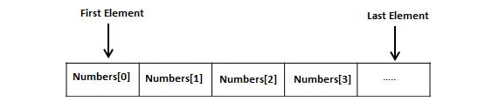
C - Arrays

Slide 4
Declaring Arrays
To declare an array in C, a programmer specifies the type of the elements and the number of elements required by an array as follows :
This is called a single-dimensional array. The arraySize must be an integer constant greater than zero and type can be any valid C data type.
For example, to declare a 10-element array called balance of type double, use this statement :
Here balance is a variable array which is sufficient to hold up to 10 double numbers.

Slide 5
Initializing Arrays
You can initialize an array in C either one by one or using a single statement as follows :
The number of values between braces { } cannot be larger than the number of elements that we declare for the array between square brackets [ ].
If you omit the size of the array, an array just big enough to hold the initialization is created.
You will create exactly the same array as you did in the previous example.

Slide 6

Initializing Arrays
Following is an example to assign a single element of the array
The above statement assigns the 5th element in the array with a value of 50.0. All arrays have 0 as the index of their first element which is also called the base index and the last index of an array will be total size of the array minus 1.
Shown below is the pictorial representation of the array we discussed above

Slide 7
Accessing Array Elements
An element is accessed by indexing the array name. This is done by placing the index of the element within square brackets after the name of the array.
For example
The above statement will take the 10th element from the array and assign the value to salary variable.
The following example Shows how to use all the three above mentioned concepts viz. declaration, assignment, and accessing arrays

Slide 8
Array…..Example
#include <stdio.h>
int main ()
{
int n[ 10 ];
int i,j;
for ( i = 0; i < 10; i++ )
{
n[ i ] = i + 100;
}
for (j = 0; j < 10; j++ )
{
printf("Element[%d] = %d\n", j, n[j] );
}
return 0;
}

Slide 9
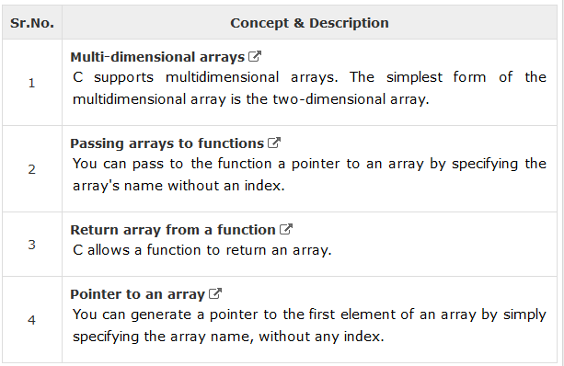
Arrays
The following important concepts related to array should be clear to a C programmer

Slide 10
C - Pointers
Some C programming tasks are performed more easily with pointers, and other tasks, such as dynamic memory allocation, cannot be performed without using pointers. So it becomes necessary to learn pointers to become a perfect C programmer.
As you know, every variable is a memory location and every memory location has its address defined which can be accessed using ampersand (&) operator, which denotes an address in memory.
Consider the following example, which prints the address of the variables defined

Slide 11
C - Pointers
#include <stdio.h>
int main ()
{
int var1;
char var2[10];
printf("Address of var1 variable: %x\n", &var1 );
printf("Address of var2 variable: %x\n", &var2 );
return 0;
}

Slide 12
What are Pointers?
A pointer is a variable whose value is the address of another variable, i.e., direct address of the memory location.
Like any variable or constant, you must declare a pointer before using it to store any variable address.
The general form of a pointer variable declaration is:

Slide 13
What are Pointers?
type is the pointer's base type; it must be a valid C data type and var-name is the name of the pointer variable.
The asterisk * used to declare a pointer is the same asterisk used for multiplication. However, in this statement the asterisk is being used to designate a variable as a pointer.

Slide 14

What are Pointers?
Take a look at some of the valid pointer declarations:
The actual data type of the value of all pointers, whether integer, float, character, or otherwise, is the same, a long hexadecimal number that represents a memory address.
The only difference between pointers of different data types is the data type of the variable or constant that the pointer points to.

Slide 15
How to Use Pointers?
There are a few important operations, which we will do with the help of pointers very frequently.
(a) We define a pointer variable,
(b) assign the address of a variable to a pointer and
(c) finally access the value at the address available in the pointer variable.
This is done by using unary operator * that returns the value of the variable located at the address specified by its operand.
The following example makes use of these operations −

Slide 16
How to Use Pointers….Example
#include <stdio.h>
int main ()
{
int var = 20;
int *ip;
ip = &var;
printf("Address of var variable: %x\n", &var );
printf("Address stored in ip variable: %x\n", ip );
printf("Value of *ip variable: %d\n", *ip );
return 0;
}

Slide 17
NULL Pointers
It is always a good practice to assign a NULL value to a pointer variable in case you do not have an exact address to be assigned.
This is done at the time of variable declaration. A pointer that is assigned NULL is called a null pointer.
The NULL pointer is a constant with a value of zero defined in several standard libraries.

Slide 18
NULL Pointers…Example
#include <stdio.h>
int main ()
{
int *ptr = NULL;
printf("The value of ptr is : %x\n", ptr );
return 0;
}

Slide 19
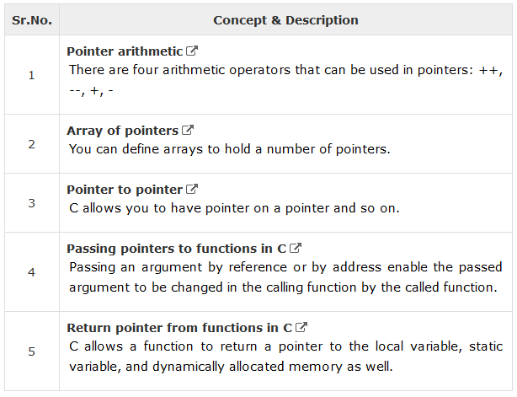
C Pointers
The following important pointer concepts should be clear to any C programmer

